Slide 1
Lecture 6
Breadth first search (BFS)
Depth first search (DFS)
Depth limited search

Slide 2

Breadth First Search (BFS)
In this strategy, the root node is expanded first, then all the nodes generated by the root node are expanded next, and then their successors, and so on.
In general, all the nodes at depth d in the search tree are expanded before the nodes at depth d + 1.
Breadth-first search can be implemented by calling the GENERAL-SEARCH algorithm with a queuing function that puts the newly generated states at the end of the queue, after all the previously generated states:

Slide 3
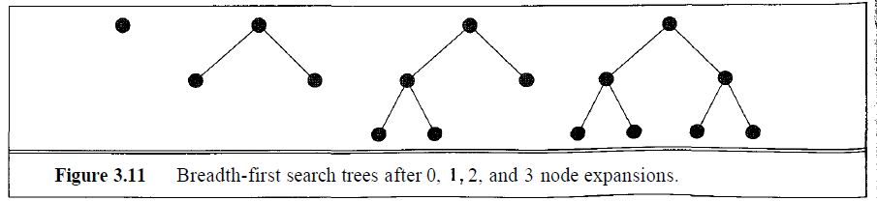
Breadth-first search is a very systematic strategy because it considers all the paths of length 1 first, then all those of length 2, and so on.
Figure shows the progress of the search on a simple binary tree.
If there is a solution, breadth-first search is guaranteed to find it, and if there are several solutions, breadth-first search will always find the shallowest goal state first.
In terms of the four criteria, breadth-first search is complete, and it is optimal provided the path cost is a non-decreasing function of the depth of the node.

Slide 4
So far, the news about breadth-first search has been good.
To see why it is not always the strategy of choice, we have to consider the amount of time and memory it takes to complete a search.
To do this, we consider a hypothetical state space where every state can be expanded to yield b new states.
We say that the branching factor of these states (and of the search tree) is b.
The root of the search tree generates b nodes at the first level, each of which generates b more nodes, for a total of b² at the second level.
Each of these generates b more nodes, yielding b³ nodes at the third level, and so on.

Slide 5
Now suppose that the solution for this problem has a path length of d.
Then the maximum number of nodes expanded before finding a solution is
1 + b + b² + ^{b3} + • • • + b^{d}
This is the maximum number, but the solution could be found at any point on the d^{th} level.
In the best case, therefore, the number would be smaller.
Those who do complexity analysis get nervous (or excited, if they are the sort of people who like a challenge) whenever they see an exponential complexity bound like O(b^{d}).
Figure in next slide shows the time and memory required for a breadth-first search with branching factor b = 10 and for various values of the solution depth d.

Slide 6
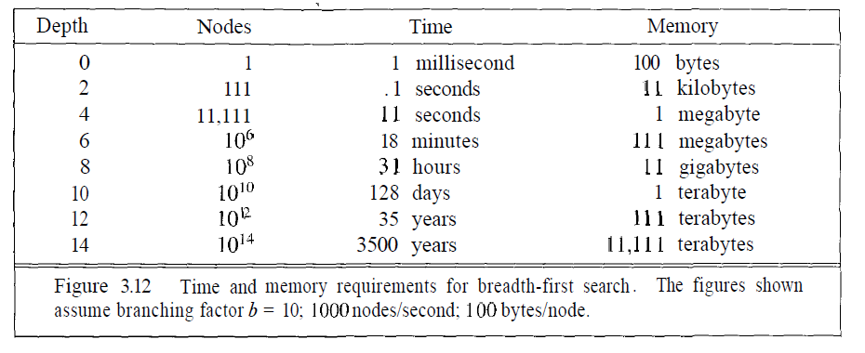

Slide 7
The space complexity is the same as the time complexity, because all the leaf nodes of the tree must be maintained in memory at the same time.
Figure in previous slide assumes that 1000 nodes can be goal-checked and expanded per second, and that a node requires 100 bytes of storage.
Many puzzle-like problems fit roughly within these assumptions (give or take a factor of 100) when run on a modern personal computer or workstation.
Two lessons to be learned from previous slide :
the memory requirements are a bigger problem for breadth-first search than the execution time.
the time requirements are still a major factor.

Slide 8
Depth First Search (DFS)
Depth-first search always expands one of the nodes at the deepest level of the tree.
Only when the search hits a dead end (a nongoal node with no expansion) does the search go back and expand nodes at shallower levels.
This strategy can be implemented by GENERAL-SEARCH with a queuing function that always puts the newly generated states at the front of the queue.
Because the expanded node was the deepest, its successors will be even deeper and are therefore now the deepest.
The progress of the search is illustrated in Figure in next slide.

Slide 9
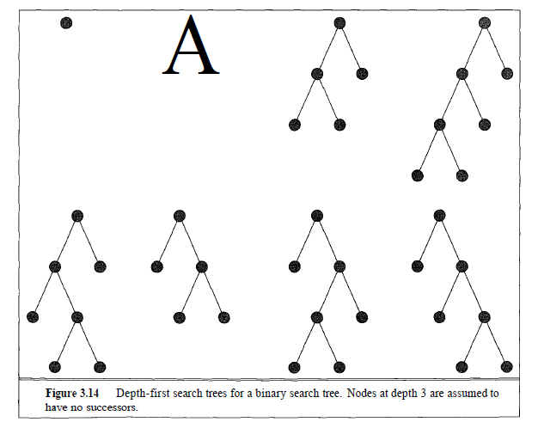

Slide 10
Depth-first search has very modest memory requirements.
As the figure shows, it needs to store only a single path from the root to a leaf node, along with the remaining unexpanded sibling nodes for each node on the path.
For a state space with branching factor b and maximum depth m, depth-first search requires storage of only bm nodes, in contrast to the b^{d} that would be required by breadth-first search in the case where the shallowest goal is at depth d.
Using the same assumptions as Figure in slide - 6, depth-first search would require 12 kilobytes instead of 111 terabytes at depth d=12,a factor of 10 billion times less space.

Slide 11
The time complexity for depth-first search is O(b^{m}).
For problems that have many solutions, depth-first may actually be faster than breadth-first, because it has a good chance of finding a solution after exploring only a small portion of the whole space.
Breadth-first search would still have to look at all the paths of length d - 1 before considering any of length d.
Depth-first search is still O(b^{m}) in the worst case.
The drawback of depth-first search is that it can get stuck going down the wrong path.
Many problems have very deep or even infinite search trees, so depth-first search will never be able to recover from an unlucky choice at one of the nodes near the top of the tree.

Slide 12
The search will always continue downward without backing up, even when a shallow solution exists.
Thus, on these problems depth-first search will either get stuck in an infinite loop and never return a solution, or it may eventually find a solution path that is longer than the optimal solution.
That means depth-first search is neither complete nor optimal.
Because of this, depth-first search should be avoided for search trees with large or infinite maximum depths.

Slide 13
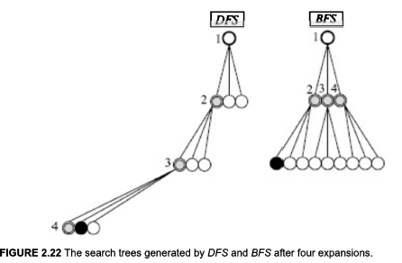

Slide 14
Depth Limited Search
Depth-limited search avoids the pitfalls of depth-first search by imposing a cutoff on the maximum depth of a path.
This cutoff can be implemented with a special depth-limited search algorithm, or by using the general search algorithm with operators that keep track of the depth.
For example, on the map of Romania, there are 20 cities, so we know that if there is a solution, then it must be of length 19 at the longest.
We can implement the depth cutoff using operators of the form "If you are in city A and have travelled a path of less than 19 steps, then generate a new state in city B with a path length that is one greater.“

Slide 15
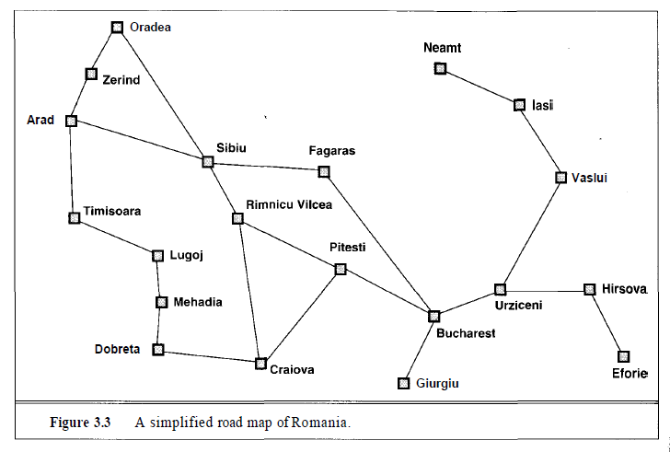

Slide 16
With this new operator set, we are guaranteed to find the solution if it exists, but we are still not guaranteed to find the shortest solution first: depth-limited search is complete but not optimal.
If we choose a depth limit that is too small, then depth-limited search is not even complete.
The time and space complexity of depth-limited search is similar to depth-first search.
It takes O(b^{l}) time and O(bl) space, where l is the depth limit.

Slide 17
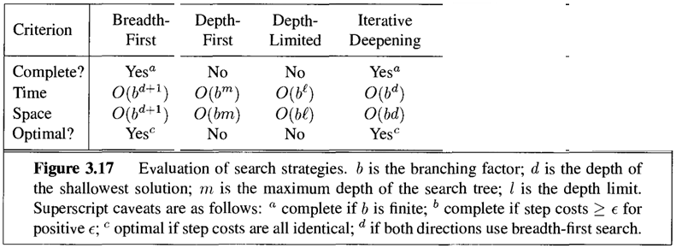
Comparison

